Slide 1
MLP Regression
Week 1

Slide 2
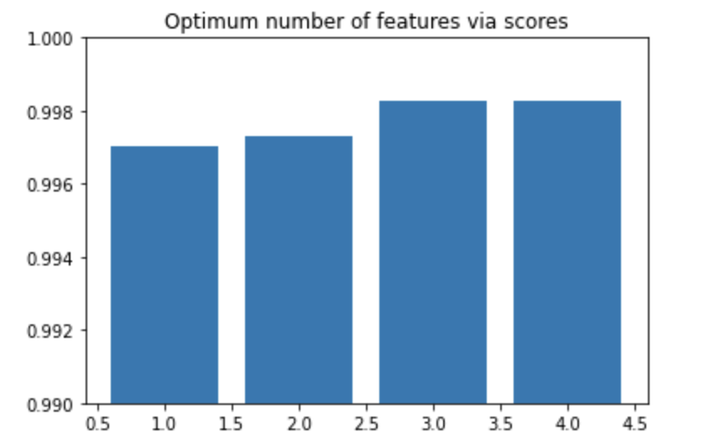
Recursive feature elimination ( feature selection )
No implementation for MLP, SVM library was used
model = SVR(kernel="linear")
rfe = RFE(model,nof_list[n])
Optimum number of features: 4
Score with 4 features: 0.998264

Slide 3
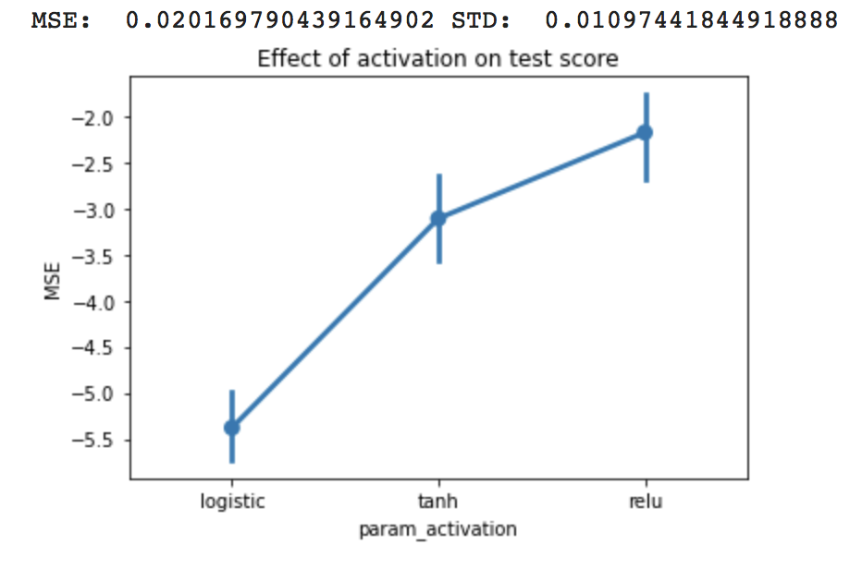
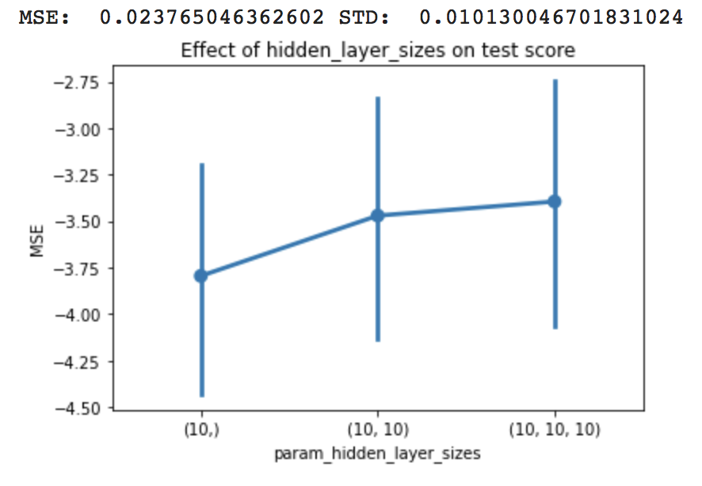
GridSearchCV best params
params = {
'activation': ['logistic', 'tanh', 'relu'],
'hidden_layer_sizes': [(10,), (10, 10), (10, 10, 10)],
'learning_rate_init': np.logspace(-3,-2,10)
}

Slide 4
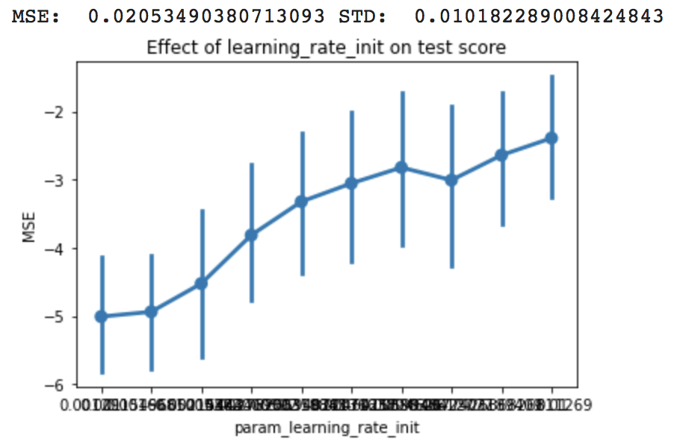
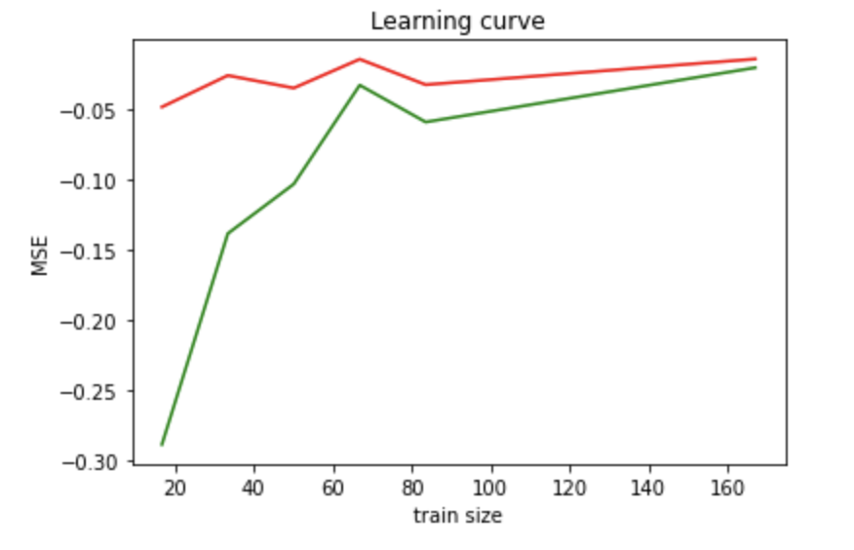
Continue

Slide 5
Soc calculation
def get_soc(final_clf, features):
soc = 0
n = 7 # for tanh
if( final_clf.get_params()['activation'] == 'relu' ):
n = 1
elif ( final_clf.get_params()['activation'] == 'logistic' ):
n = 3
for i in final_clf.get_params()['hidden_layer_sizes']:
soc += ( 2 * features + n * i )
features = i
soc += 2 * features * final_clf.n_outputs_
return soc

Slide 6
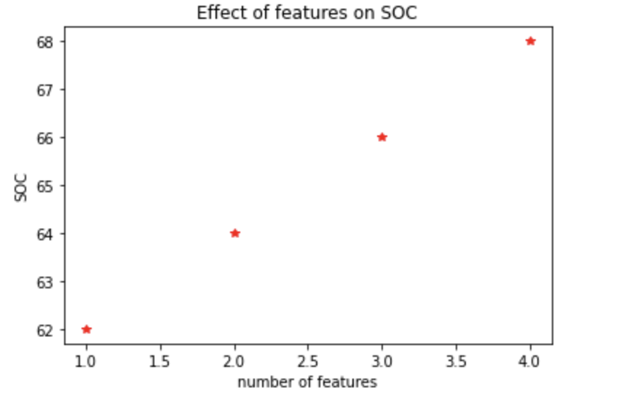
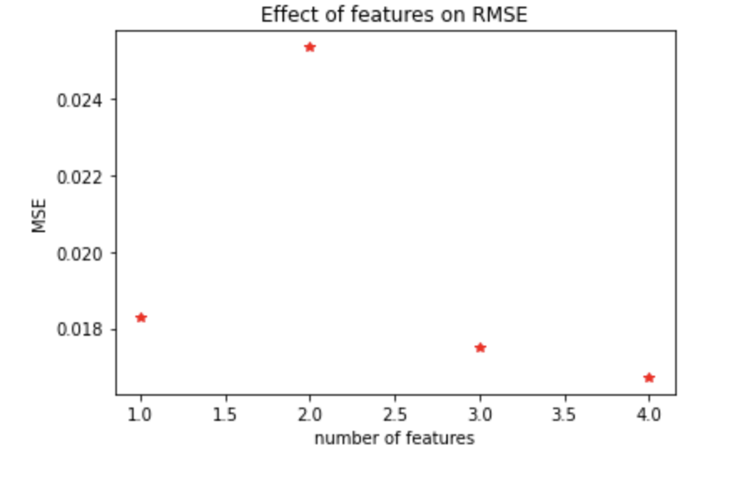
Continue

